Slide 1
CMSC 603
High-Performance Distributed Systems
OpenMP
Dr. Preetam Ghosh
Professor
Department of Computer Science
pghosh@vcu.edu

Slide 2

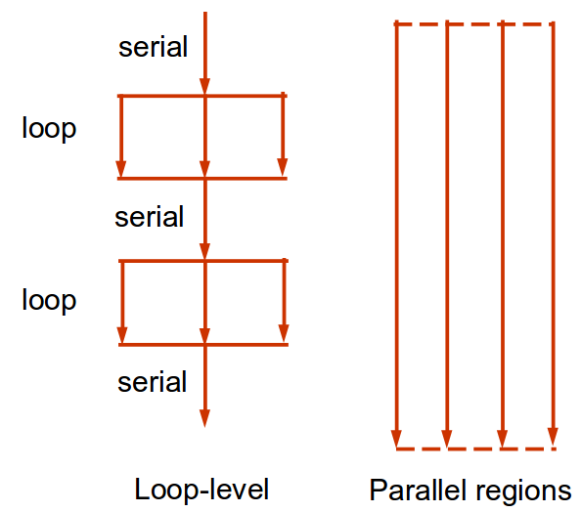
CMSC 603 - HPDS
OpenMP
OpenMP (Open Multi-Processing)
  API for shared memory parallel programming in C/C++/Fortran
  Compiler directives and library routines for Windows / Linux / OS X
  Higher level of abstraction than POSIX threads
  Easy to use, incremental parallelization, flexible, portable
  Basic approaches:
    Loop-level parallelism
    Parallel regions

Slide 3
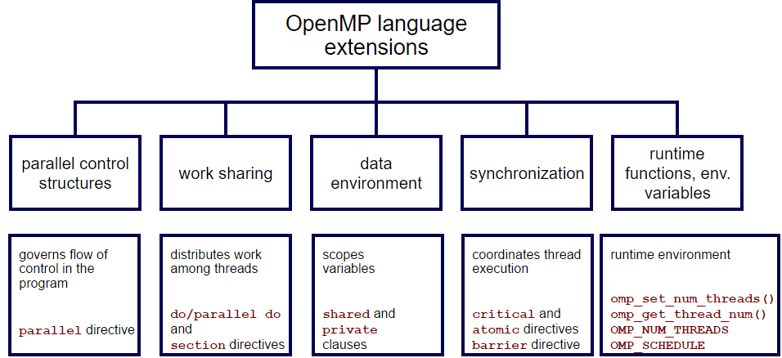
CMSC 603 - HPDS
OpenMP
OpenMP (Open Multi-Processing)
  Core elements

Slide 4
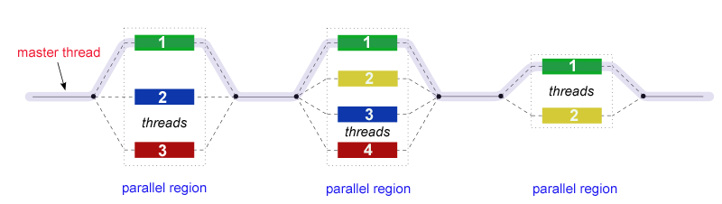
CMSC 603 - HPDS
OpenMP
OpenMP: fork-join
  OpenMP uses the fork-join model of parallel execution
  OpenMP programs begin as a single process: the master thread, which executes sequentially until parallel regions are encountered.
  FORK: the master thread then creates a team of parallel threads.
  Statements in the program that are enclosed by the parallel region are then executed in parallel among the various team threads.
  JOIN: When the threads complete the statements in the parallel region, they synchronize and terminate, leaving only the master thread.

Slide 5
CMSC 603 - HPDS
OpenMP
Thread creation: Hello World!
  The pragma omp parallel is used to fork additional threads
  Compile gcc -fopenmp hello.c -o hello
  By default it creates as many threads as the number of cores
  omp_set_num_threads(nthreads); optional, to override default #threads
  Example: hello.c
void main() {
omp_set_num_threads(8);
#pragma omp parallel
{
int tid = omp_get_thread_num();
int nthreads = omp_get_num_threads();
printf("Hello world thread %d, total %d\n", tid, nthreads);
}
}

Slide 6
CMSC 603 - HPDS
OpenMP
Loop-level parallelism
  The loop workload will be automatically parallelized into nthreads, each one computing (size / nthreads) sums
  Implies a barrier at the end of the loop
  Easy and transparent scalability!
  num_threads(nthreads) optional, allows to specify the number of threads
  Example: parallelfor.c
#pragma omp parallel for num_threads(4)
for(int i = 0; i < size; i++)
{
c[i] = a[i] + b[i];
}

Slide 7
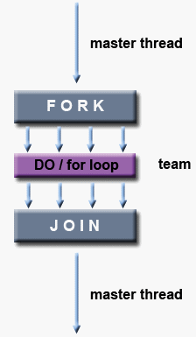
CMSC 603 - HPDS
OpenMP
Loop-level parallelism vs parallel region
  How workload is shared among threads and the divisibility problem
#pragma omp parallel for
for(int i = 0; i < size; i++)
c[i] = a[i] + b[i];
#pragma omp parallel
{
int id, nthrds, start, end;
id = omp_get_thread_num();
nthrds = omp_get_num_threads();
start = id * size / nthrds; // Warning: integer division
end = (id+1) * size / nthrds; // Warning: integer division
if (id == nthrds-1) end = size;
for(int i = start; i < end; i++)
c[i] = a[i] + b[i];
}
  Examples: parallelfor2.c and parallelfor3.c

Slide 8

CMSC 603 - HPDS
OpenMP
Shared and private variables
  In parallel region, the default behavior is that all variables are shared except loop index, which is private for each thread
  It’s ok when all threads read and write different memory locations, accessing different elements of an array. The problem happens if threads write same scalar or array element, example:
  All threads use the same instance of “result” for their calculation
int result;
#pragma omp parallel for
for(int i = 0; i < size; i++)
{
result = a[i] + b[i];
c[i] = result;
}

Slide 9
CMSC 603 - HPDS
OpenMP
Shared and private variables
  private creates a separate memory location for the variable for each thread
  Data races happen among the threads!
  Let’s see the behavior of the code with/without the private clause
  Example: private.c
int result;
#pragma omp parallel for private(result)
for(int i = 0; i < size; i++)
{
result = a[i] + b[i];
c[i] = result;
}

Slide 10
CMSC 603 - HPDS
OpenMP
Shared and private variables
  default none allows to define all variables as shared or private
  Explicit control of the behavior per shared or private variable
  Loop iterator is always private
int result;
#pragma omp parallel for default (none) \
shared (size,a,b,c) \
private(result)
for(int i = 0; i < size; i++)
{
result = a[i] + b[i];
c[i] = res;
}

Slide 11
CMSC 603 - HPDS
OpenMP
Data dependencies
  Cannot assume threads will run in any specific order
  Example: Fibonacci sequence
  Easy test for checking dependencies: if the serial loop is executed in reverse order, will it give the same result?
  Be careful when calling dependent and non-reentrant functions
seq[0] = 0;
seq[1] = 1;
for(int i = 3; i < size; i++)
{
seq[i] = seq[i-1] + seq[i-2];
}

Slide 12
CMSC 603 - HPDS
OpenMP
Reduction
  Operation that applies to all of the elements of an array (e.g. sum all values)
  Results from all threads are automatically reduced at the end
  Operators: +, *, -, /, &, ^, |, &&, ||, min, max
  Roundoff error may be different than serial case (e.g. Kahan summation algorithm to reduce the numerical error)
  Example: reduction.c
int sum = 0;
#pragma omp parallel for reduction(+:sum)
for(int i = 0; i < size; i++)
{
sum += array[i];
}

Slide 13
CMSC 603 - HPDS
OpenMP
Performance hints
  OpenMP will do what you tell it to do, be aware of dependencies
  Do not parallelize small loops, overhead may be > than speedup!
  Parallelize outer loops, maximize number of parallel operations
  Merge parallel sections (minimize overheads) if data dependencies allow
#pragma omp parallel
#pragma omp for
for(int i = 0; i < size1; i++)
...
#pragma omp for
for(int i = 0; i < size2; i++)
...
#pragma omp parallel end

Slide 14

CMSC 603 - HPDS
OpenMP
Behavior
  What’s the difference between these three codes?
#pragma omp parallel for
for(int i = 0; i < size; i++)
...
#pragma omp parallel
#pragma omp for
for(int i = 0; i < size; i++)
...
#pragma omp parallel end
#pragma omp parallel
for(int i = 0; i < size; i++)
...
#pragma omp parallel end

Slide 15
CMSC 603 - HPDS
OpenMP
Sections
  Sections can be used to allocate workload to a thread
#pragma omp parallel sections
{
#pragma omp section
{
// Do something by one thread
printf ("id = %d, \n", omp_get_thread_num());
}
#pragma omp section
{
// Do something by another thread
printf ("id = %d, \n", omp_get_thread_num());
}
#pragma omp section
{
// Do something by yet another thread
printf ("id = %d, \n", omp_get_thread_num());
}
}
  Example: sections.c

Slide 16


CMSC 603 - HPDS
OpenMP
Nested loops
  collapse: Specifies how many loops in a nested loop should be collapsed into one large iteration space and divided according to the schedule clause. The sequential execution of the iterations in all associated loops determines the order of the iterations in the collapsed iteration space.
#pragma omp parallel for
for(int i = 0; i < size; i++)
{
#pragma omp parallel for
for(int j = 0; j < size; j++) {
...
}
}
#pragma omp parallel for collapse(2)
for(int i = 0; i < size; i++)
{
for(int j = 0; j < size; j++) {
...
}
}

Slide 17
CMSC 603 - HPDS
OpenMP
Barriers
  Synchronization point, threads wait until all threads arrive
Master / single
  Forces a single unique thread to execute a section
#pragma omp parallel
{
do_many_things();
#pragma omp barrier
do_many_other_things();
}
#pragma omp parallel
{
do_many_things();
#pragma omp single
{ exchange_boundaries(); }
// implicit synchronization
do_many_other_things();
}
#pragma omp parallel
{
do_many_things();
#pragma omp master
{ exchange_boundaries(); }
// no synchronization implied
do_many_other_things();
}

Slide 18
CMSC 603 - HPDS
OpenMP
Critical sections
  Mutual exclusion: only one thread at a time can enter a critical section. All unnamed critical sections are mutually exclusive.
  Atomic: provides mutual exclusion (lower overhead, specific operations)
  Example: critical.c
int counter = 0;
#pragma omp parallel num_threads(1000)
{
#pragma omp critical (counteraccess) // name the critical
counter++;
}
int counter = 0;
#pragma omp parallel num_threads(1000)
{
#pragma omp atomic
counter++;
}

Slide 19
CMSC 603 - HPDS
OpenMP
Forcing sequential execution
Locks
Example: performance.c
Exercise: compare the performance of critical, atomic, and locks (openMP vs threads)
#pragma omp parallel for ordered
{
#pragma omp ordered
printf(“Thread %d\n”, omp_get_thread_num());
}
omp_lock_t lock;
omp_init_lock(&lock);
#pragma omp parallel
{
omp_set_lock(&lock);
... // critical section
omp_unset_lock(&lock);
}
omp_destroy_lock(&lock);

Slide 20
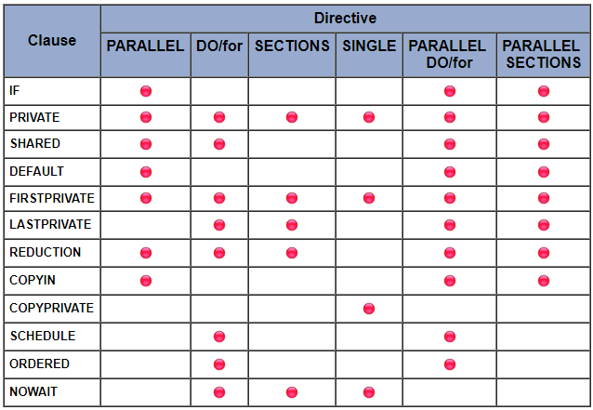
CMSC 603 - HPDS
OpenMP
OpenMP directives and clauses (Reference guide)

Slide 21
CMSC 603 - HPDS
OpenMP
Matrix multiplication
  Computational complexity O(n^3)
  Identify opportunities for parallelization
for(int i = 0; i < size; i++)
{
for(int j = 0; j < size; j++)
{
double tmp = 0.0;
for(int k = 0; k < size; k++)
tmp += a[i*size + k] * b[k*size + j];
c[i*size + j] = tmp;
}
}
  Example: matrixmultiplication.c

Slide 22
CMSC 603
High-Performance Distributed Systems
OpenMP
Dr. Preetam Ghosh
Professor
Department of Computer Science
pghosh@vcu.edu

